Slide 1
Computer Organization Principles
School of Software, Dalian University of Technology
Chi Lin (林驰)
chilin@mail.dlut.edu.cn

Slide 2
Teaching Assistant
Xinjiao Li(李欣娇)
Cell: 18106363717
Lab:综合楼2楼

Slide 3
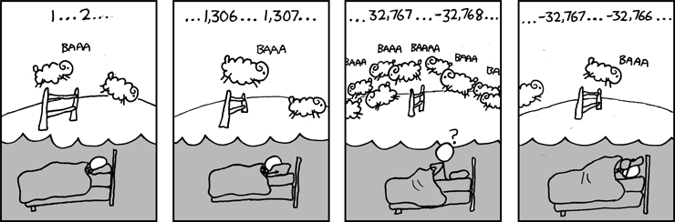
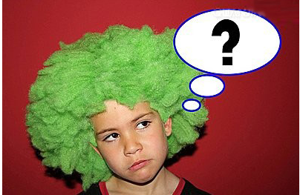
Great Reality #1: Ints are not Integers, Floats are not Reals
Carnegie Mellon
Example 1: Is x² ≥ 0?
Float’s: Yes!
Int’s:
40000 * 40000 = 1600000000
50000 * 50000 = ??
Example 2: Is (x + y) + z = x + (y + z)?
Unsigned & Signed Int’s: Yes!
Float’s:
(1e20 + -1e20) + 3.14 --> 3.14
1e20 + (-1e20 + 3.14) --> ??
Notes:
Count sheep

Slide 4
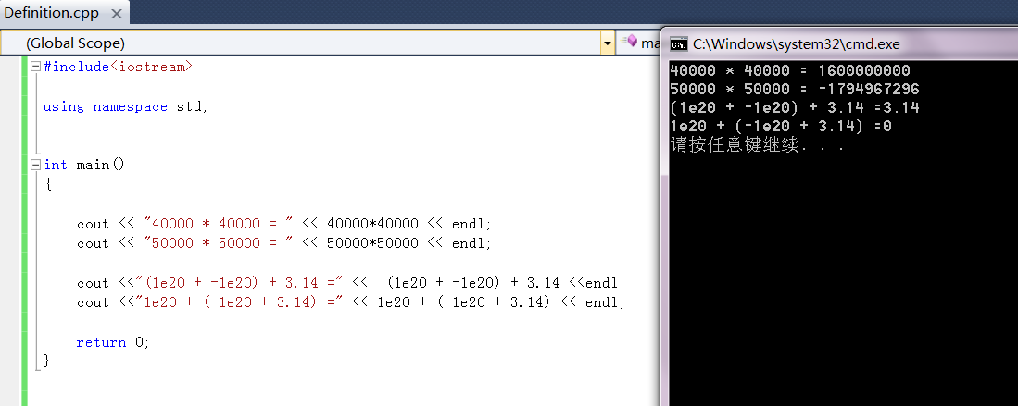
Results Developed by Visual Studio

Slide 5
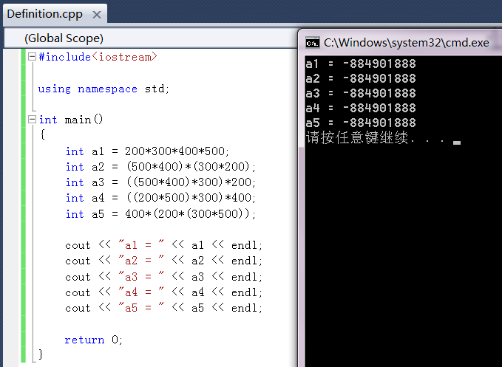
Integer Multiplication

Slide 6
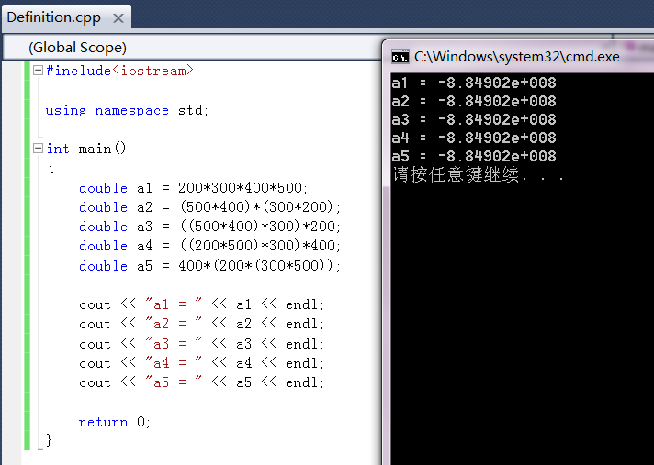
Take care of the Implicit Conversion

Slide 7
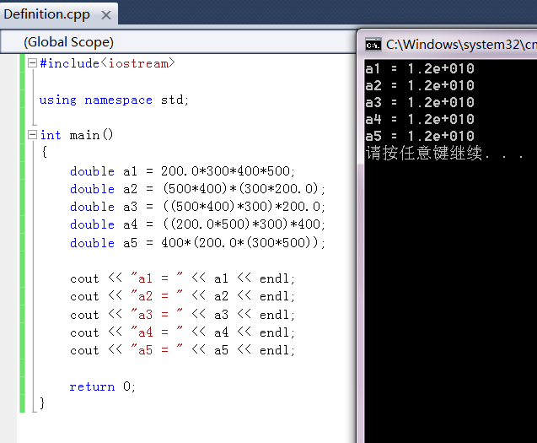
Float Point Multiplication
Observasion:
Calculations does not generate random values

Slide 8
Code Security Example
Carnegie Mellon
/* Kernel memory region holding user-accessible data */
#define KSIZE 1024
char kbuf[KSIZE];
/* Copy at most maxlen bytes from kernel region to user buffer */
int copy_from_kernel(void *user_dest, int maxlen) {
/* Byte count len is minimum of buffer size and maxlen */
int len = KSIZE < maxlen ? KSIZE : maxlen;
memcpy(user_dest, kbuf, len);
return len;
}
Similar to code found in FreeBSD’s implementation of getpeername
There are legions of smart people trying to find vulnerabilities in programs

Slide 9
Typical Usage
Carnegie Mellon
/* Kernel memory region holding user-accessible data */
#define KSIZE 1024
char kbuf[KSIZE];
/* Copy at most maxlen bytes from kernel region to user buffer */
int copy_from_kernel(void *user_dest, int maxlen) {
/* Byte count len is minimum of buffer size and maxlen */
int len = KSIZE < maxlen ? KSIZE : maxlen;
memcpy(user_dest, kbuf, len);
return len;
}
#define MSIZE 528
void getstuff() {
char mybuf[MSIZE];
copy_from_kernel(mybuf, MSIZE);
printf(“%s\n”, mybuf);
}

Slide 10
Malicious Usage
Carnegie Mellon
/* Kernel memory region holding user-accessible data */
#define KSIZE 1024
char kbuf[KSIZE];
/* Copy at most maxlen bytes from kernel region to user buffer */
int copy_from_kernel(void *user_dest, int maxlen) {
/* Byte count len is minimum of buffer size and maxlen */
int len = KSIZE < maxlen ? KSIZE : maxlen;
memcpy(user_dest, kbuf, len);
return len;
}
#define MSIZE 528
void getstuff() {
char mybuf[MSIZE];
copy_from_kernel(mybuf, -MSIZE);
. . .
}

Slide 11
Observasions
Carnegie Mellon
Calculations does not generate random values
Cannot assume all “usual” mathematical properties
Need to understand which abstractions apply in which contexts
Important issues for compiler writers and serious application programmers
OK, let’s go!!!!

Slide 12
Chapter 3 Representing & Manipulating Information
Contents
Data Representation & Encoding
Integer Representations
Integer Arithmetic
Floating Point
Arithmetic Logical Unit (ALU)

Slide 13
Chapter 3 Representing & Manipulating Information
Contents
Data Representation & Encoding
Integer Representations
Integer Arithmetic
Floating Point
Arithmetic Logical Unit (ALU)

Slide 14
Data Representation & Encoding
Binary Representation
Bit, Byte, Word
Byte Ordering
Bit-level Operation
Signed & Unsigned Number
Character & Strings

Slide 15
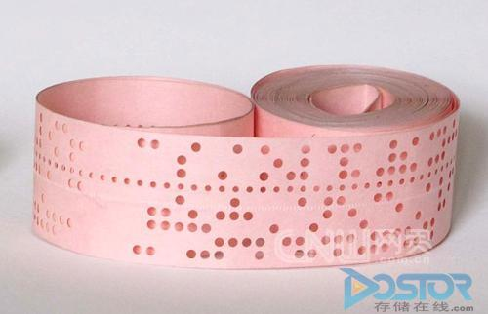
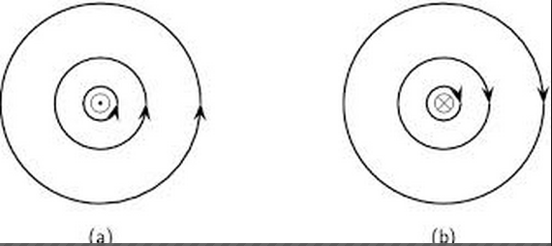
Binary Representations：3 cases
0
1
0
Voltage
3.3V
2.8V
0.5V
0.0V
Punched Card
Magnetic

Slide 16
Bit
A bit is the basic unit of information in computing and digital communications.
A bit can have only one of two values, and may therefore be physically implemented with a two-state device. These values are most commonly represented as 0 and 1.
Why do you think binary representation is more promising than decimal especially in the computer field?

Slide 17
Quantum computer (量子计算机)
A quantum computer maintains a sequence of qubits(量子位). A single qubit can represent a one, a zero, or any quantum superposition(量子叠加) of those two qubit states; a pair of qubits can be in any quantum superposition of 4 states, and three qubits in any superposition of 8 states.

Slide 18
Bit Representations & Interpretation
In isolation, a single bit is not very useful.
When we group bits together and apply some interpretation that gives meaning to the different possible bit patterns, we can represent the elements of any finite set (Numbers, Strings, Pictures, etc.).

Slide 19
Bit, Byte & Word
Bit: A single binary digit, that can have either value 0 or 1.
Byte(字节): 8 bits.
Word(字): Usually 32 bits depends on system architecture
Halfword(半字): 16 bits
Doubleword(双字): 64 bits

Slide 20
Unit Transformation
1 Kilo Byte（KB） = 1024 byte
1 Mega Byte（MB） = 1024 KB
1 Giga Byte （GB）= 1024 MB
1 Tera Byte（TB）= 1024 GB
1 Peta Byte（PB） = 1024 TB

Slide 21
Two confusing problems
I bought a 64G u disk, when I open it, only 57.6G is shown on the screen, what’s wrong?
For manufactory, 1000 not 1024 is preferred when expressing the storage capacity. 64 000 000 000 GB / (1024 * 1024 * 1024) ≈ 59G
The network operator said my bandwidth is 10Mb/s, when I check the speed, only approximately 1MB/s is obtained, what’s wrong?
10Mb/s = 10/8 ≈ 1MB/s. The approximation is applied due to the delay and non-deterministic factors in the networks

Slide 22
Encoding Byte Values
Decimal
Hex
Binary
Byte = 8 bits
Binary 000000002 to 111111112
Decimal: 010 to 25510
Hexadecimal 0016 to FF16
Base 16 number representation
Use characters ‘0’ to ‘9’ and ‘A’ to ‘F’
Write FA1D37B16 in C as
0xFA1D37B
0xfa1d37b
0
0
0000
1
1
0001
2
2
0010
3
3
0011
4
4
0100
5
5
0101
6
6
0110
7
7
0111
8
8
1000
9
9
1001
A
10
1010
B
11
1011
C
12
1100
D
13
1101
E
14
1110
F
15
1111

Slide 23
Conversions between Binary, Hexadecimal and Decimal
Binary <===> Hexadecimal
Binary <===> Decimal
Hexadecimal <===> Decimal

Slide 24
Binary <===> Hexadecimal
0011 0101 1101 = 0x35d
0xFDC24= 1111 1101 0010 0100

Slide 25
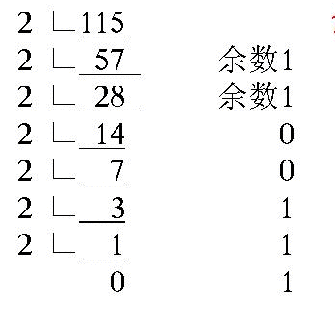

Binary <===> Decimal
115 = 1110011b
10011101 = 157

Slide 26
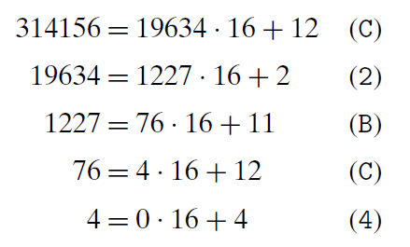
Hexadecimal <==> Decimal
314156=0x04CB2C
0x4CB2C=4*16^4+C*16^3+B*16^2+2*16+C=314156

Slide 27
Byte-Oriented Memory Organization
00•••0
FF•••F
• • •
Programs Refer to Virtual Addresses
Conceptually very large array of bytes
Actually implemented with hierarchy of different memory types

Slide 28
Machine Words
Machine Has “Word Size”
Nominal size of integer-valued data
Including addresses
Most current machines use 32 bits (4 bytes) words
Limits addresses to 4GB
Becoming too small for memory-intensive applications

Slide 29
Machine Words
High-end systems use 64 bits (8 bytes) words
Potential address space ≈ 1.8 X 10¹⁹ bytes
x86-64 machines support 48-bit addresses: 256 Terabytes
Machines support multiple data formats
Fractions or multiples of word size
Always integral number of bytes

Slide 30
Word-Oriented Memory Organization
32-bit
Words
64-bit
Words
Bytes
Addr.
0000
Addr
=
??
0001
Addresses Specify Byte Locations
Address of first byte in word
Addresses of successive words differ by 4 (32-bit) or 8 (64-bit)
0000
0002
Addr
=
??
0003
0000
0004
Addr
=
??
0005
0004
0006
0007
0008
Addr
=
??
0009
0008
0010
Addr
=
??
0011
0008
0012
Addr
=
??
0013
0012
0014
0015

Slide 31
Data Representations (in Bytes)
C Data Type | Typical 32-bit | Intel IA32 | x86-64
char | 1 | 1 | 1
short | 2 | 2 | 2
int | 4 | 4 | 4
long | 4 | 4 | 8
long long | 8 | 8 | 8
float | 4 | 4 | 4
double | 8 | 8 | 8
long double | 8 | 10/12 | 10/16
pointer | 4 | 4 | 8

Slide 32
Group Discussion
The size of a pointer is 4 Bytes, why ?
A pointer is an address !
Therefore, the size should be equal to the machine word

Slide 33
Byte Ordering
How should bytes within a multi-byte word be ordered in memory?
Conventions
Big Endian: Sun, PPC Mac, Internet
Least significant byte has highest address
Little Endian: x86
Least significant byte has lowest address

Slide 34
Byte Ordering Example
Big Endian
Least significant byte has highest address
Little Endian
Least significant byte has lowest address

Slide 35
Big Endian & Small Endian
Example
Variable x has 4-byte representation 0x01234567
Address given by &x is 0x100
Big Endian
0x100
0x101
0x102
0x103
01
01
23
23
45
45
67
67
Little Endian
0x100
0x101
0x102
0x103
67
67
45
45
23
23
01
01

Slide 36
Reading Byte-Reversed Listings
Disassembly (反汇编)
Text representation of binary machine code
Generated by program that reads the machine code
Example Fragment
Deciphering Numbers
Value: 0x12ab
Pad to 32 bits: 0x000012ab
Split into bytes: 00 00 12 ab
Reverse: ab 12 00 00
Address Instruction Code Assembly Rendition
8048365: 5b pop %ebx
8048366: 81 c3 ab 12 00 00 add $0x12ab,%ebx
804836c: 83 bb 28 00 00 00 00 cmpl $0x0,0x28(%ebx)

Slide 37
Test
Write a C/C++ program to test whether your computer is big endian or small endian
Or you can design some other solutions.

Slide 38
Examining Data Representations
Code to Print Byte Representation of Data
Casting pointer to unsigned char * creates byte array
typedef unsigned char *pointer;
void show_bytes(pointer start, int len){
int i;
for (i = 0; i < len; i++)
printf(”%p\t0x%.2x\n",start+i, start[i]);
printf("\n");
}
Printf directives:
%p: Print pointer
%x: Print Hexadecimal
Notes:
把地址转化成无符号数，显示在地址中存储的字节

Slide 39
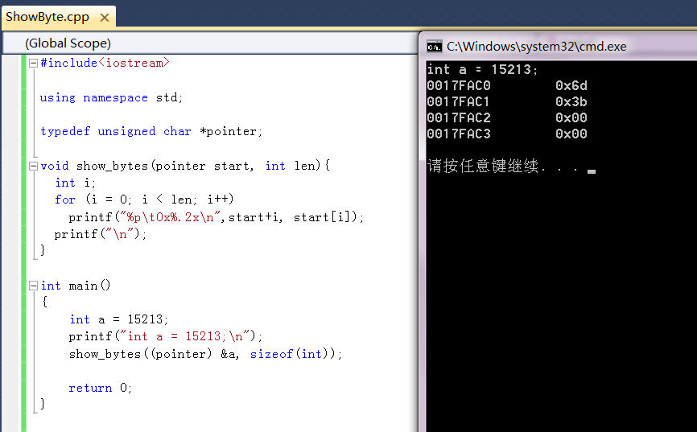
show_bytes Execution Example
int a = 15213;
printf("int a = 15213;\n");
show_bytes((pointer) &a, sizeof(int));
Result (Linux):
int a = 15213;
0x11ffffcb8 0x6d
0x11ffffcb9 0x3b
0x11ffffcba 0x00
0x11ffffcbb 0x00
15213 = 0x3b6d

Slide 40
Representing Integers
Decimal: 15213
Binary: 0011 1011 0110 1101
Hex: 3 B 6 D
int A = 15213;
long int C = 15213;
IA32, x86-64
Sun
IA32
x86-64
Sun
6D
00
3B
00
6D
6D
00
00
3B
3B
3B
00
00
6D
00
00
3B
00
00
6D
00
int B = -15213;
00
IA32, x86-64
Sun
00
00
93
FF
C4
FF
FF
C4
FF
93
Two’s complement representation
(Covered later)

Slide 41
Representing Pointers (Different Pointer Address)
Sun
IA32
x86-64
int B = -15213;
int *P = &B;
EF
FF
FB
2C
D4
F8
FF
BF
0C
89
EC
FF
FF
7F
00
00
Different compilers & machines assign different locations to objects

Slide 42
Boolean Algebra
Developed by George Boole in 19th Century
Algebraic representation of logic
Encode “True” as 1 and “False” as 0

Slide 43
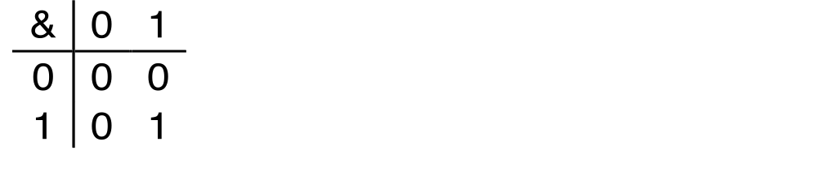
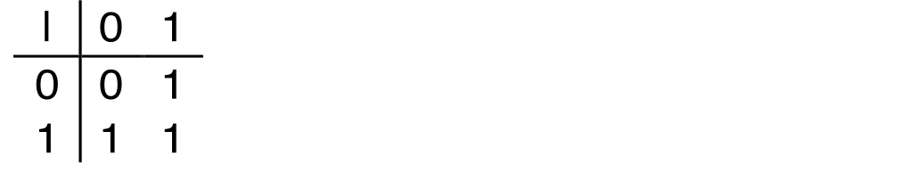
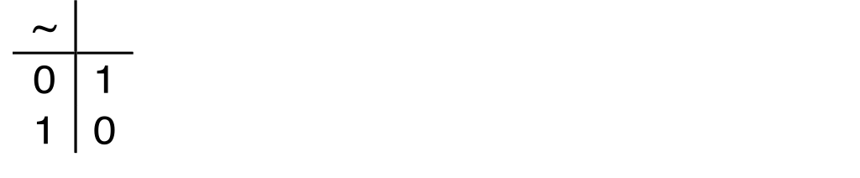
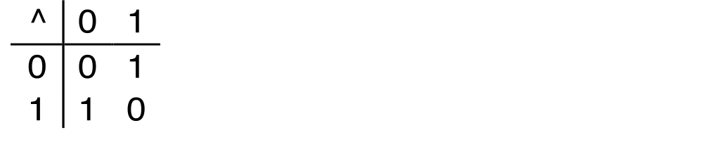
Boolean Algebra
And
A&B = 1 when both A=1 and B=1
Or
A|B = 1 when either A=1 or B=1
Not
~A = 1 when A=0
Exclusive-Or (Xor)
A^B = 1 when either A=1 or B=1, but not both

Slide 44
Application of Boolean Algebra
Applied to Digital Systems by Claude Shannon
1937 MIT Master’s Thesis
Reason about networks of relay switches
Encode closed switch as 1, open switch as 0
A&~B
Connection when
A&~B | ~A&B
A
~B
~A
B
~A&B
= A^B

Slide 45
General Boolean Algebras
Operate on Bit Vectors
Operations applied bitwise
All of the Properties of Boolean Algebra Apply
01101001
& 01010101
01000001
01101001
| 01010101
01111101
01101001
^ 01010101
00111100
~ 01010101
10101010
01000001
01111101
00111100
10101010

Slide 46
Representing & Manipulating Sets
Representation
Width w bit vector represents subsets of {0, …, w–1}
a_{j} = 1 if j ∈ A
01101001 { 0, 3, 5, 6 }
76543210
01010101 { 0, 2, 4, 6 }
76543210

Slide 47
Representing & Manipulating Sets
a=01101001
b=01010101
Operations
& Intersection 01000001 { 0, 6 }
| Union 01111101 { 0, 2, 3, 4, 5, 6 }
^ Symmetric difference 00111100 { 2, 3, 4, 5 }
~ Complement 10101010 { 1, 3, 5, 7 }

Slide 48
Bit-Level Operations in C
Operations &, |, ~, ^ Available in C
Apply to any “integral” data type
long, int, short, char, unsigned
View arguments as bit vectors
Arguments applied bit-wise

Slide 49
Examples (Char data type)
~0x41 = 0xBE
~010000012 =101111102
~0x00 = 0xFF
~000000002 =111111112
0x69 & 0x55 = 0x41
011010012 & 010101012 = 010000012
0x69 | 0x55 = 0x7D
011010012 | 010101012 = 011111012

Slide 50
Contrast: Logic Operations in C
Contrast to Logical Operators
&&, ||, !
View 0 as “False”
Anything nonzero as “True”
Always return 0 or 1
Early termination
Examples (char data type)
!0x41 = 0x00
!0x00 = 0x01
!!0x41 = 0x01
0x69 && 0x55 = 0x01
0x69 || 0x55 = 0x01
p && *p (avoids null pointer access)

Slide 51
Shift Operations
Left Shift: x << y
Shift bit-vector x left y positions
Throw away extra bits on left
Fill with 0’s on right
Right Shift: x >> y
Shift bit-vector x right y positions
Throw away extra bits on right
Logical shift
Fill with 0’s on left
Arithmetic shift
Replicate most significant bit on right
Argument x
01100010
<< 3
00010000
00010000
00010000
Log. >> 2
00011000
00011000
00011000
Arith. >> 2
00011000
00011000
00011000
Argument x
10100010
<< 3
00010000
00010000
00010000
Log. >> 2
00101000
00101000
00101000
Arith. >> 2
11101000
11101000
11101000

Slide 52
Question
How to use XOR to exchange two variables x and y.
x=x^y; y=y^x; x=x^y;

Slide 53
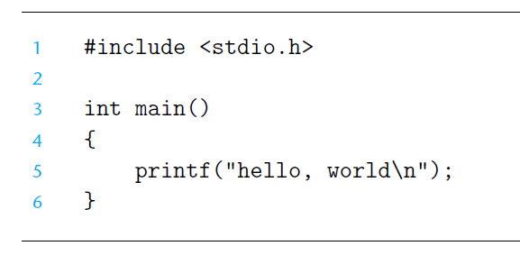
Character & Strings Representations

Slide 54
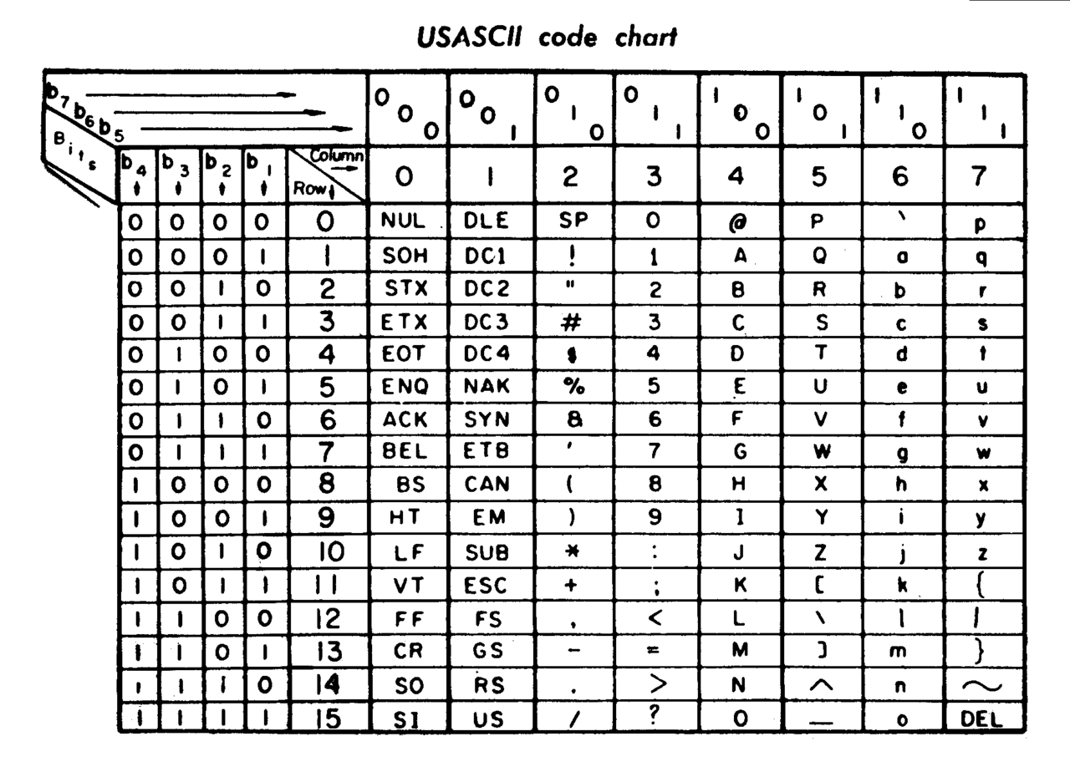
ASCII Code
128 specified characters :
numbers 0-9,
letters a-z and A-Z,
some basic punctuation symbols,
some control codes
a blank space

Slide 55
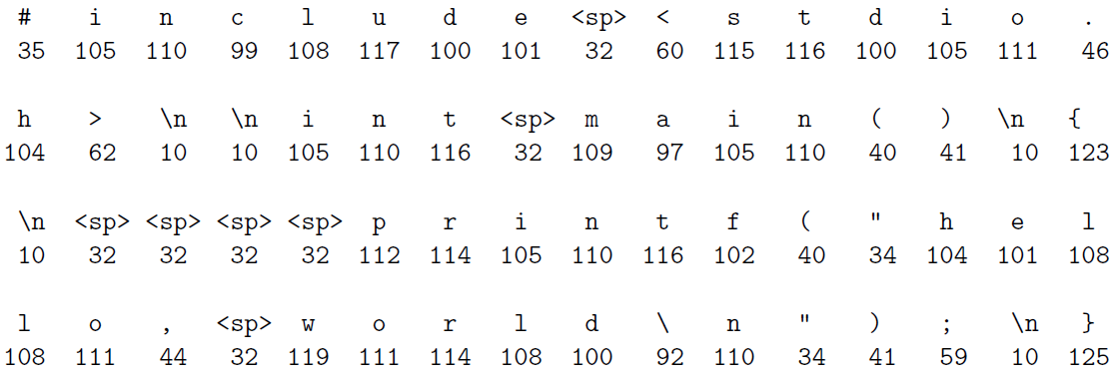
Code Converting and File Storing

Slide 56
Homework
Practice Problem 2.2, 2.3, 2.4, 2.5, 2.9, 2.10, 2.14 2.16
Requirements:
Explicit calculation details.
No cheating

Slide 57
Thank You

